Slide 1
Diagnosing NMO Optic Neuritis:
Imaging and OCT features
EUNOS June 2019
Eoin O’Sullivan
Eye Department
King’s College Hospital
London, UK
Notes:
7th November, 15:00-15:45 hrs:
- What is seronegative NMO?

Slide 2
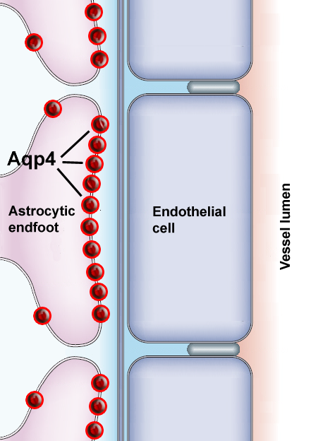
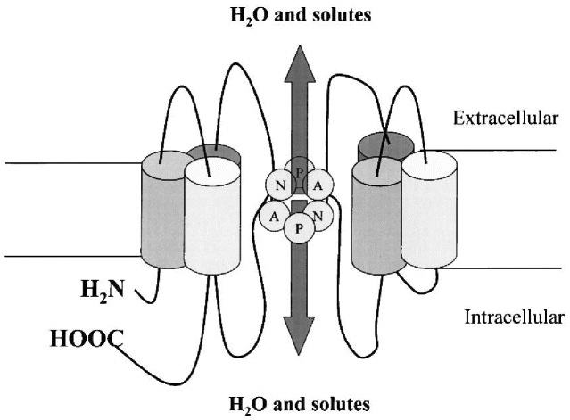
Lennon et al Lancet 2004; J Ex Med 2005
Aquaporin-4
most abundant water channel in CNS
concentrated in astrocytic foot processes
Notes:
AQP 4 concentrated Astrocytic foot processes Aquaporin-4 (AQP4) is a water channel protein expressed in astrocytes throughout the CNS. In brain, AQP4 facilitates water balance and glial scar formation, which are important determinants of outcome after injury. In brain, AQP4 deletion remarkably impairs astrocyte migration and reduces glial scarring after a stab injury (Saadoun et al.,
2005; Auguste et al., 2007). In general, AQP4 becomes upregulated after central nervous system (CNS) injury including focal cerebral ischaemia in mice (Ribeiro Mde et al., 2006), brain inflammatory diseases in humans (Aoki-Yoshino et al., 2005), meningitis in mice (Papadopoulos and Verkman, 2005), traumatic brain injury in rats (Sun et al., 2003), and human brain tumours
2004). AQP4 deficiency, however, was associated with increased baseline spinal cord water content, consistent with our findings in AQP4/ mouse brain (Manley et al., 2000; Papadopoulos et al.,
2004; Bloch et al., 2005, 2006). Elevated CNS water content in AQP4/ mice may result from expansion of CNS extracellular space (ECS) volume (

Slide 3
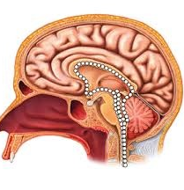
AQP4 expression
Brain
ON + Retina
Muller cell
AQP4
Retina
Choroid
Sclera
Spinal Cord
Astrocyte
AQP4
Notes:
Diffuse grey matter staining and atrsocyte foot process esp around vessels pos in white matter (arrowheads AFP) arrows AFP around vessels

Slide 4
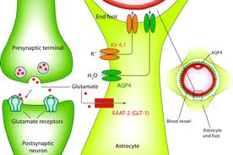
Antibodies to AQP4 → astrocytopathy
reduced glutamate uptake → secondary myelin damage
GLUTAMATE
AQP4
excitatory amino acid transporter
Notes:
Transporter appear similar to channels prime process to remove extracellular glutamate

Slide 5
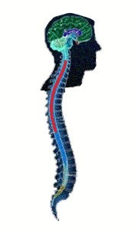
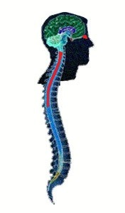
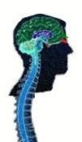
Neuromyelitis optica spectrum disorder
2015 Definition
NMOSD
female,
non-Caucasian,
severe disability
auto-immune diseases relapsing
AQP4-Ab positive
disease
AQP4-Ab negative
attacks from 2 sites:
≥ 1 from ON, SC, area postrema,
brainstem, diencephalic, cerebral
1 site
eg R ON
R LETM
Wingerchuk et al 2015 Neurology 85:1

Slide 6
2015 Definition
NMOSD
AQP4-Ab positive disease
attack 1 site:
ON / TM / area postrema / brainstem
or
narcolepsy / diencephalic / cerebral w typical MRI
AQP4-Ab negative
w typical MRI
attack 2 sites w typical MRI:
≥ 1 from ON, SC, area postrema,
brainstem, diencephalic, cerebral
w typical MRI

Slide 7
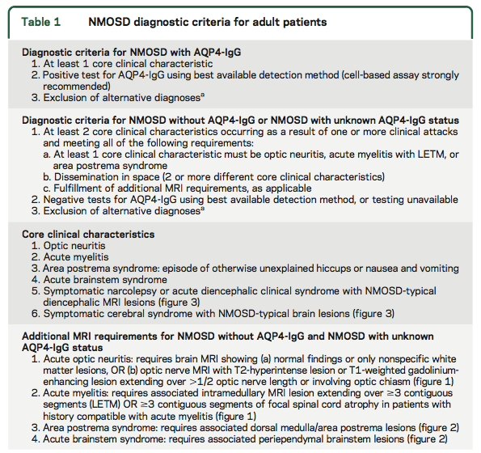

Slide 8
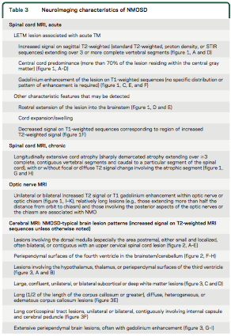

Slide 9
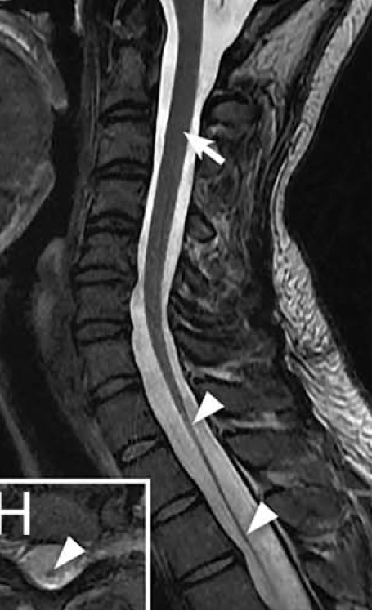
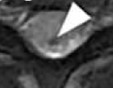
ACUTE MYELITIS
LETM ≥ 3 vertebral segments
or chronic

Slide 10
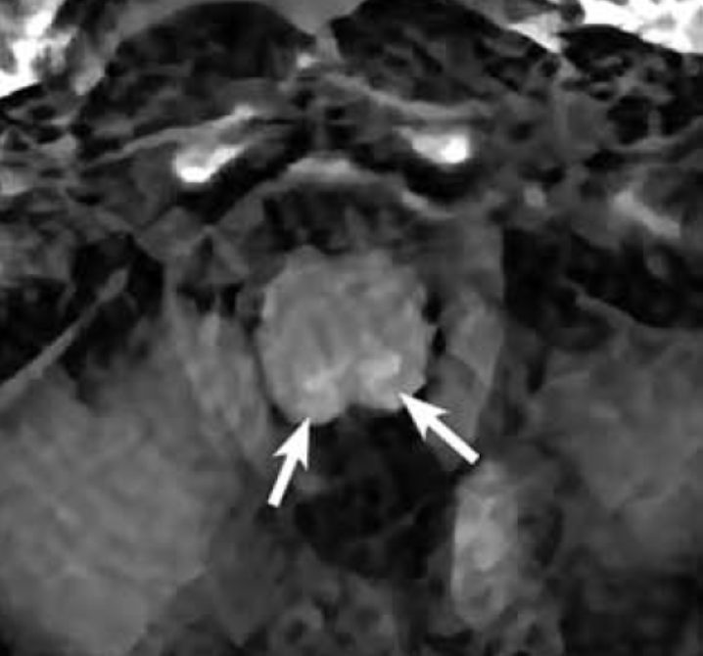
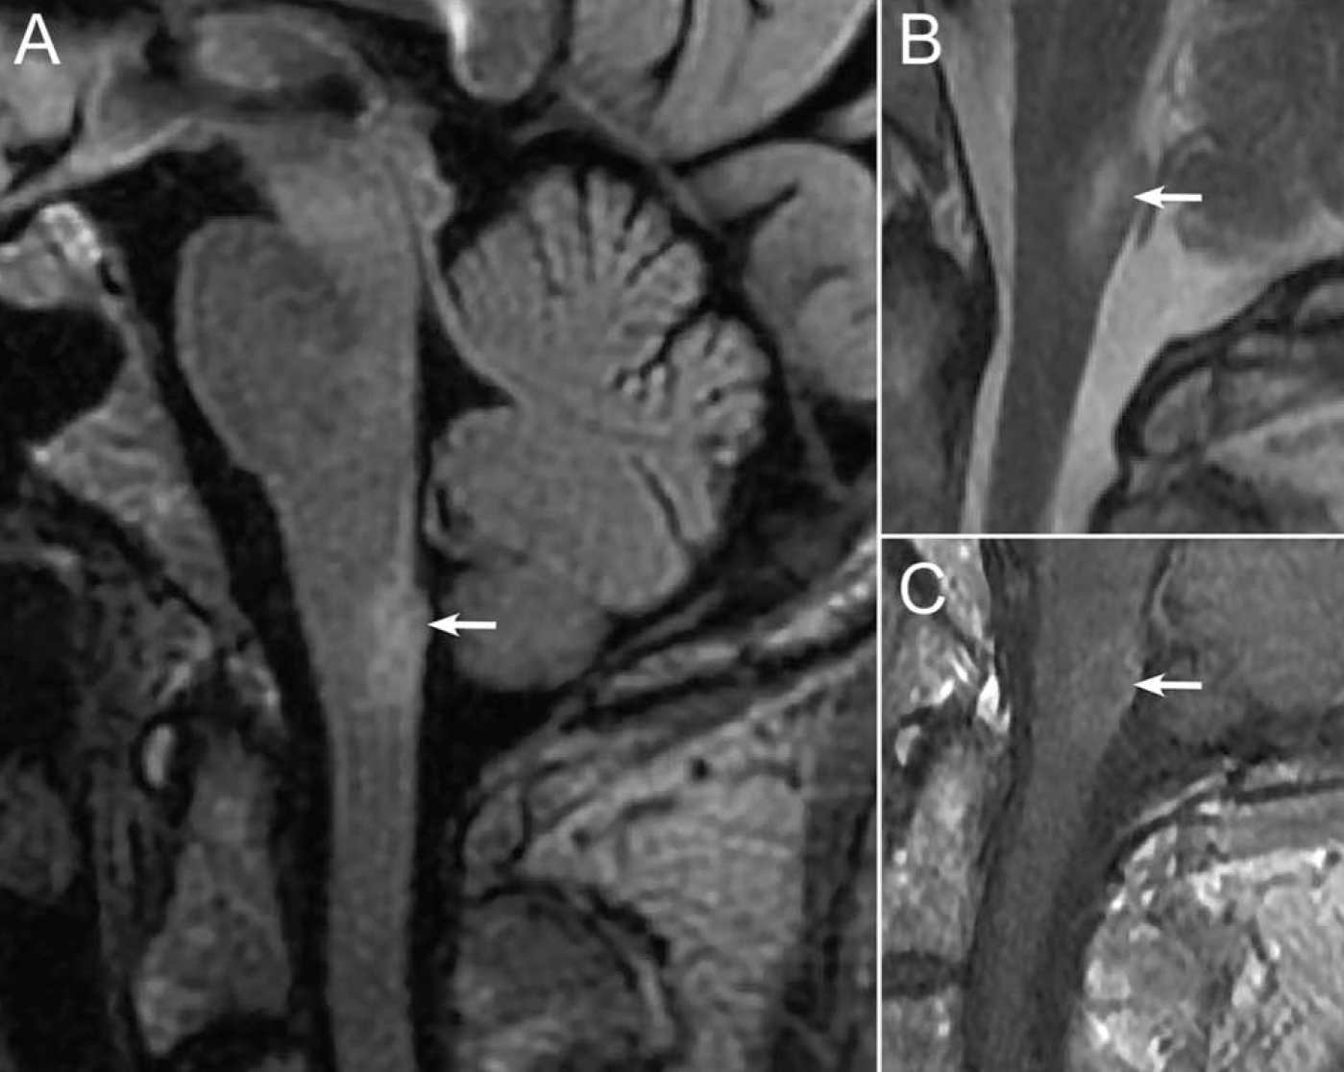
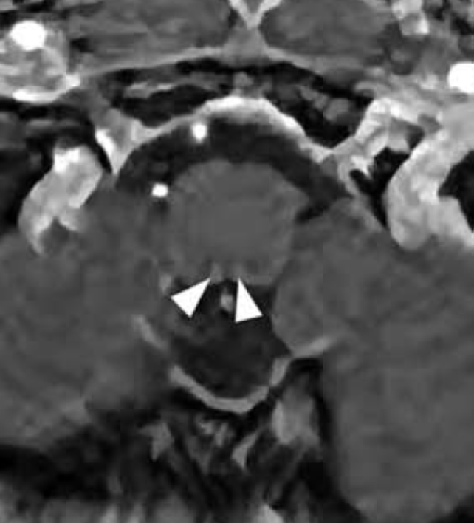
AREA POSTREMA ATTACK
Area postrema / dorsal medulla
*
*
Notes:
Dorsal medulla (and sagittal and gad) w area postreme syndrome
Dorsal medulla (and gad) area postreme syndrome axial

Slide 11
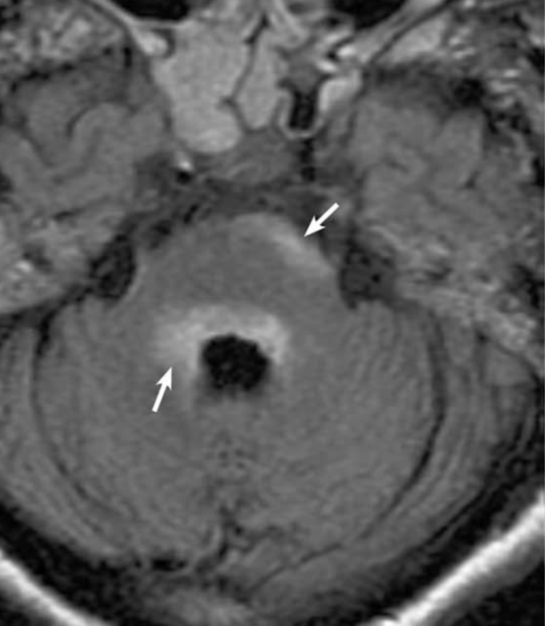
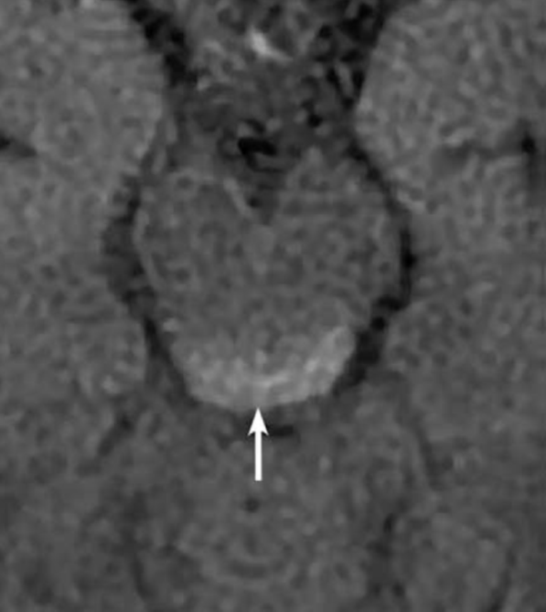
BRAINSTEM ATTACK
Periependymal lesions
Notes:
periependymal pons
dosal midbrain

Slide 12
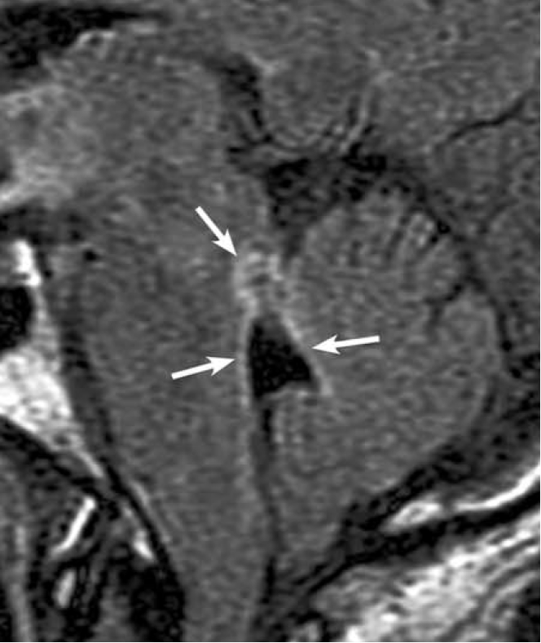
4th ventricle
Viegas et al, 2009 JNNP 80:679
Notes:
Flair signal around 4th ventricle

Slide 13
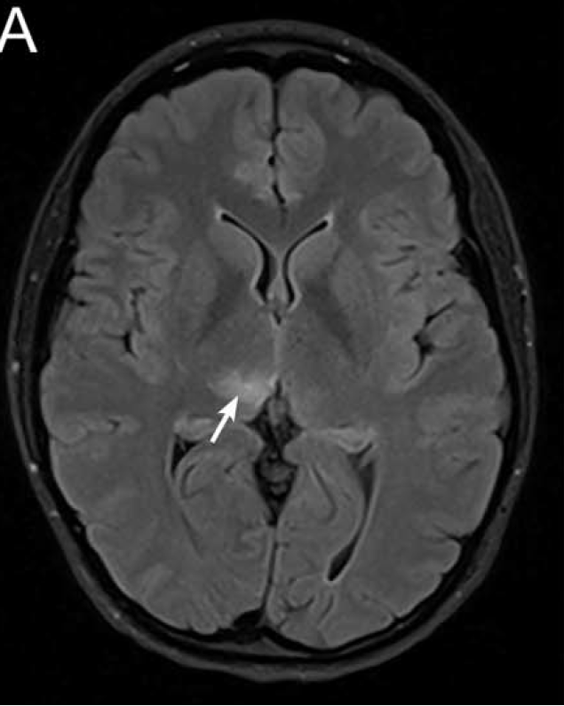
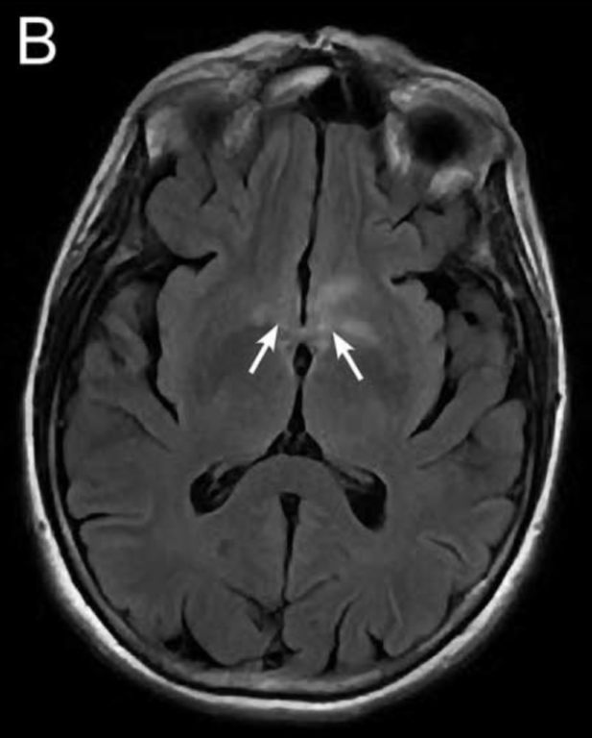
NARCOLEPSY OR DIENCEPHALIC ATTACK
NMOSD typical Diencephalic lesions
thalamus
hypothalamus
Viegas et al, 2009 JNNP 80:679
Wingerchuk et al 2015 Neurology 85:1
Notes:
Flair signal around 4th ventricle

Slide 14
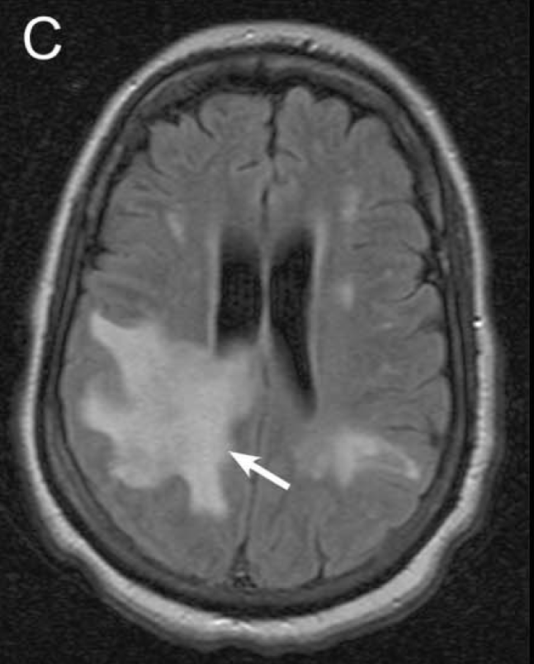
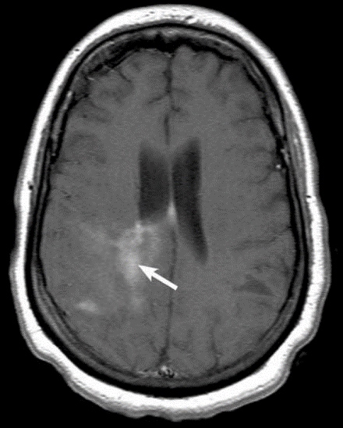
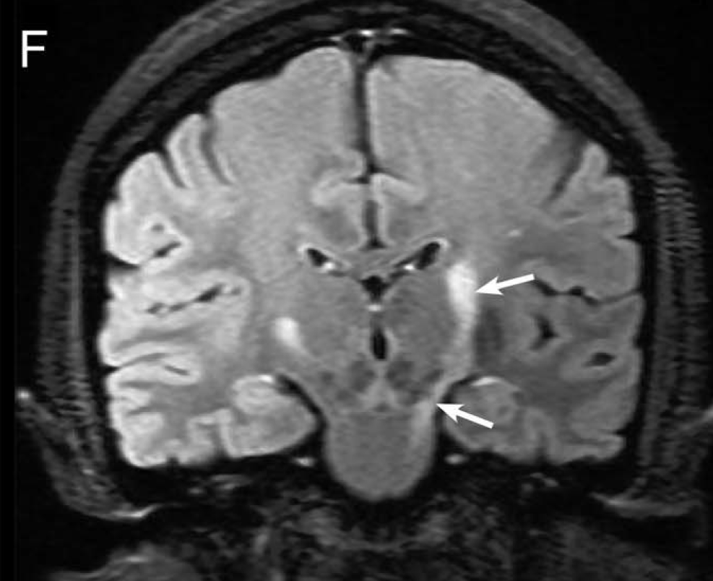
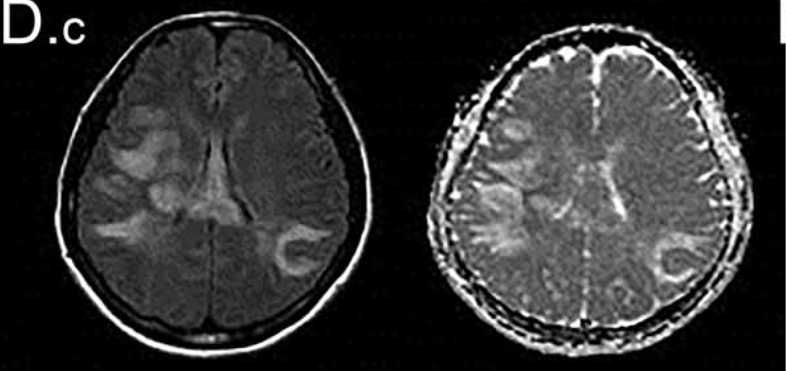
CEREBRAL ATTACK
NMOSD ‘typical’ brain lesions
Long CS tract lesion
*
Kim et al Neurology 2015;84:1165
Notes:
Extensive subcortical WML enhances
extensive confluent hemisphere changes with )also increased diffusivity suhggesting vasogenic oedema)
Long extensive CST lesions

Slide 15
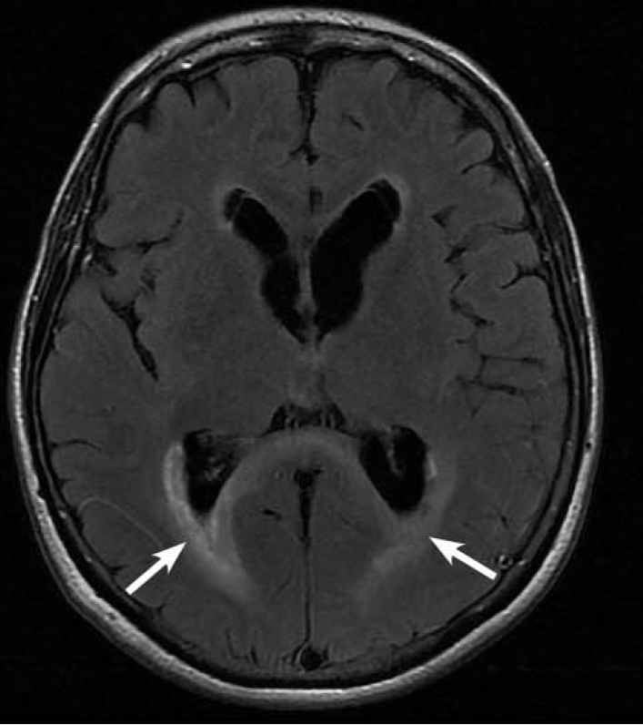
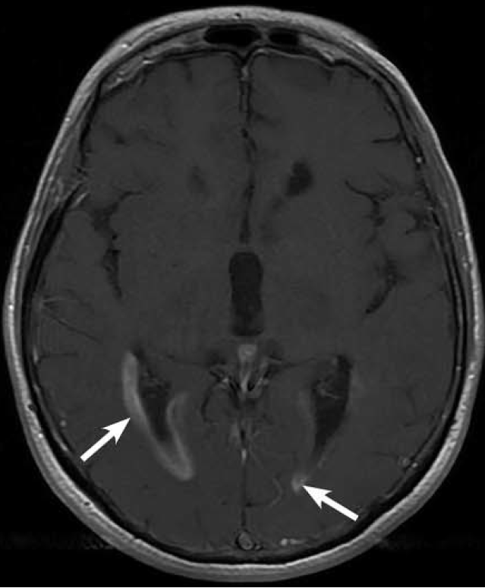
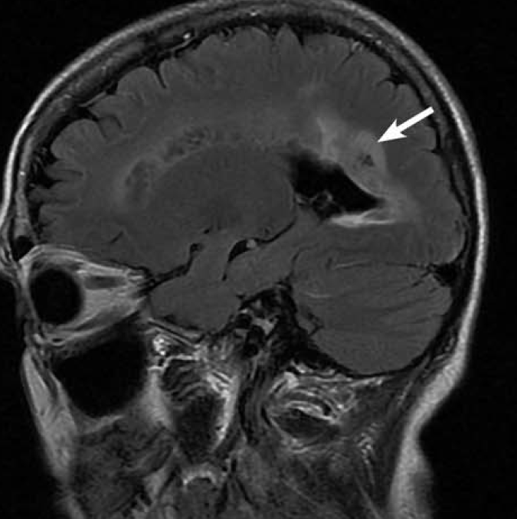
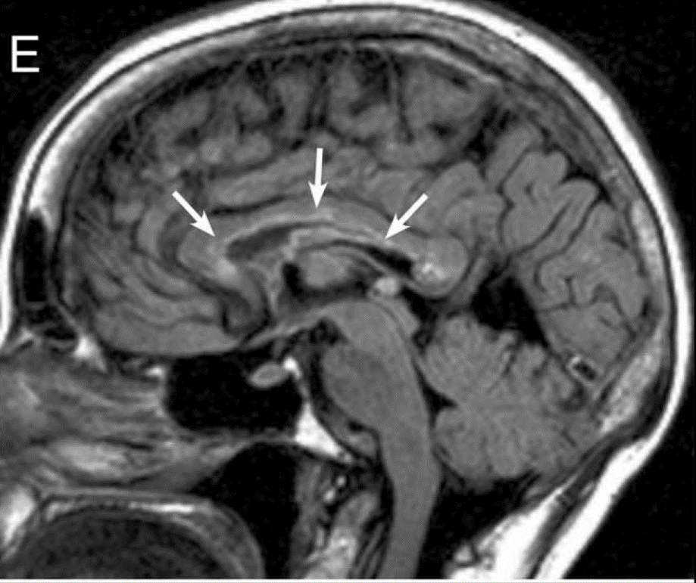
CEREBRAL ATTACK
Peri ependymal / ventricular lesions/CC
Kim et al Neurology 2015;84:1165
*
Notes:
Axial flair, gad and sagittal long extensive CC lesions
Arch bridge callosal signal

Slide 16
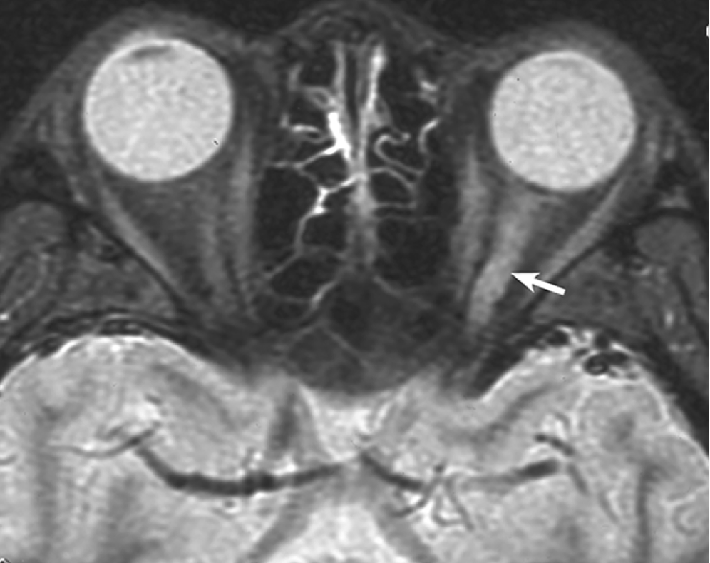
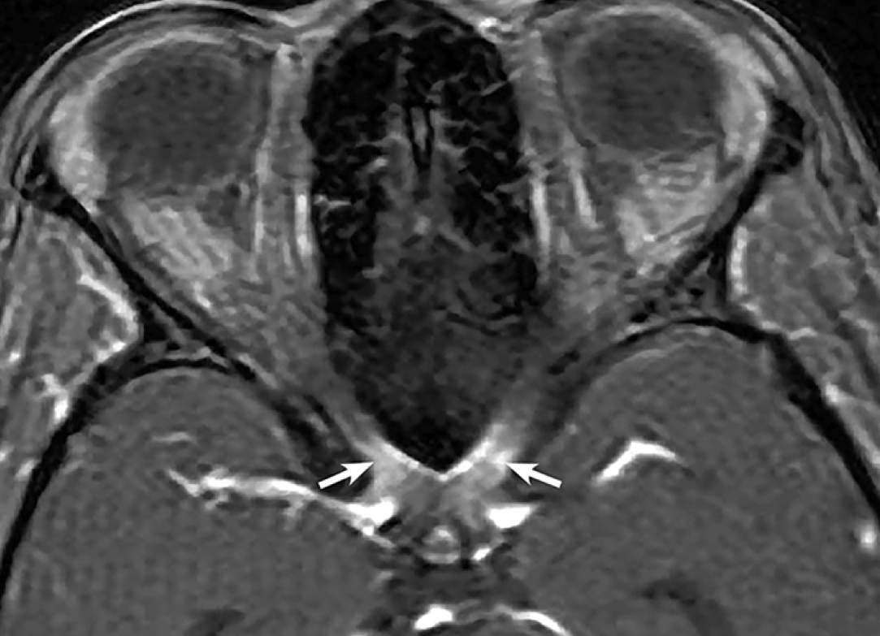
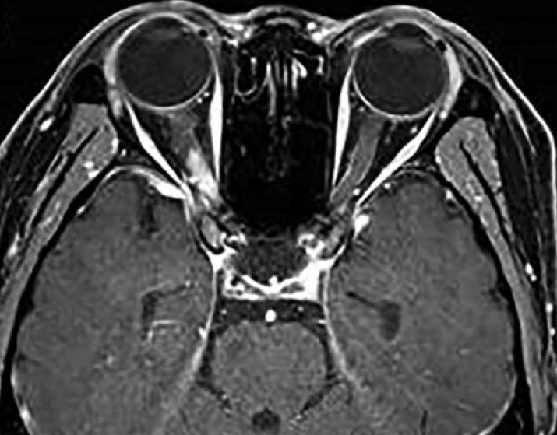
OPTIC NEURITIS
> ½ ON length or chiasmatic involvement or tract
(normal or non-specific white matter lesions)
*
*
Kim et al Neurology 2015;84:1165
Notes:
Fat suppressed T2 L ON Gad chiasm Gad Rt post ON

Slide 17
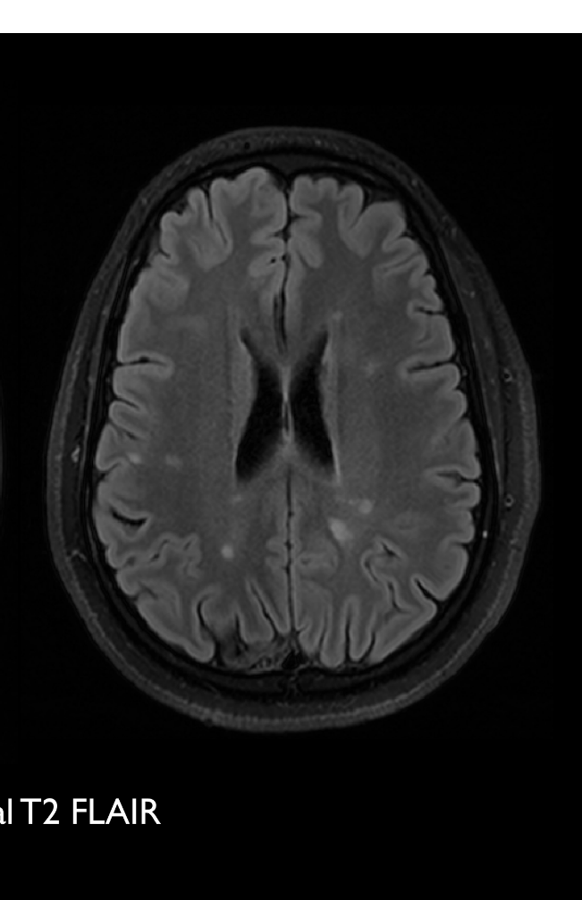
AQP4-Ab Brain MRI
̴<10% have characteristic peri-ependymal or diencephalic
Not infrequently normal
Non-specific WML commonest ab^{n}

Slide 18
2015 Definition
Wingerchuk
NMOSD
AQP4-Ab positive disease
attack 1 site:
ON / TM / area postrema / brainstem
or
narcolepsy / diencephalic / cerebral w typical MRI
AQP4-Ab negative
̴ 25%
w typical MRI
attack 2 sites w typical MRI:
≥ 1 from ON, SC, area postrema,
brainstem, diencephalic, cerebral
w typical MRI
MOG-Ab
positive
disease

Slide 19
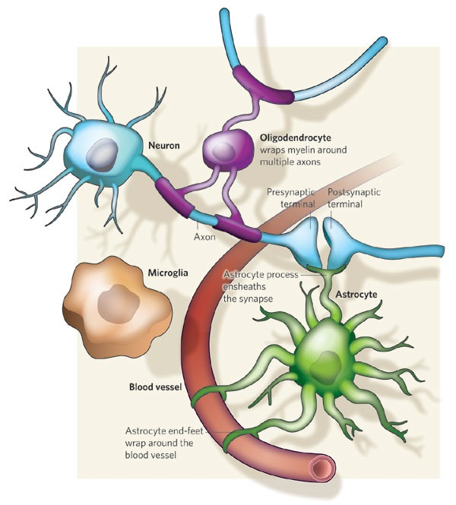
MOG
AQP4
myelin oligodendrocyte glycoprotein

Slide 20
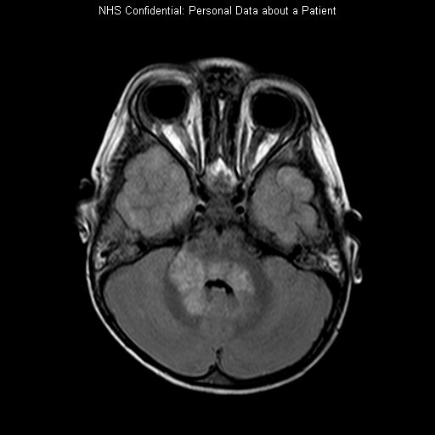
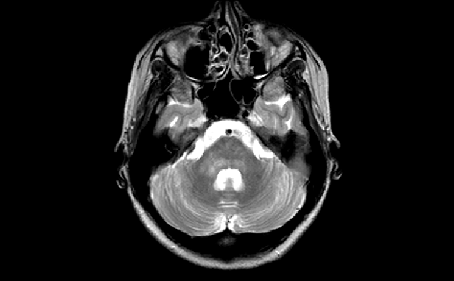
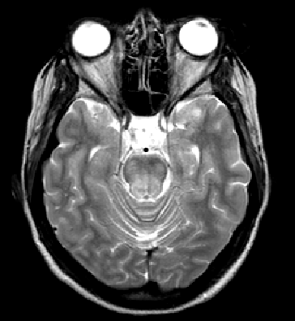
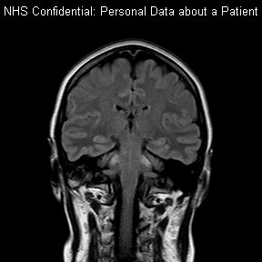
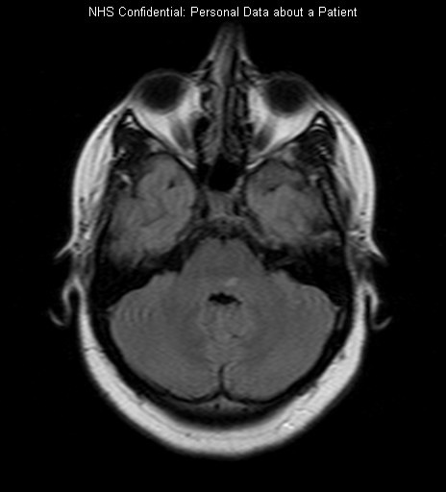
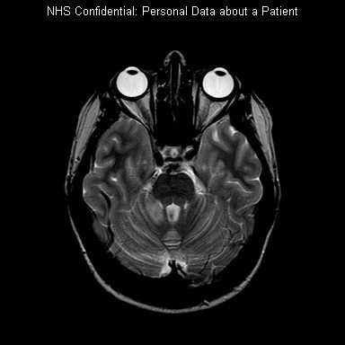
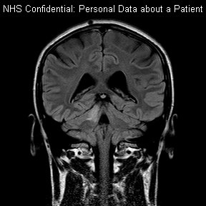
Brainstem lesions in MOG-IgG1+ve patients
Maciej Juryńczyk
2yr-old child
adult
adult
adult
adult

Slide 21
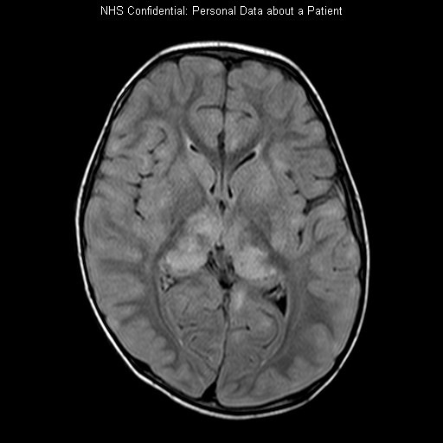
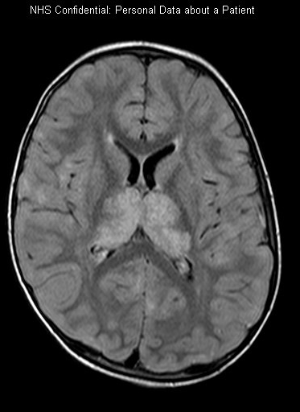
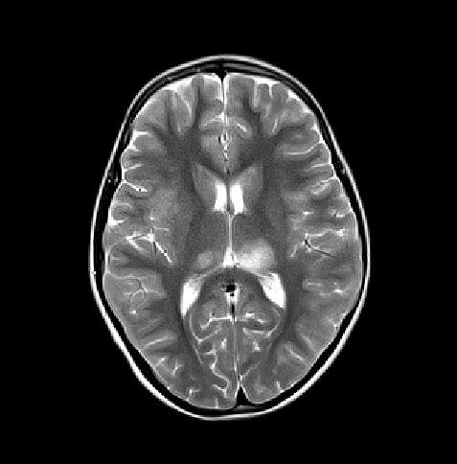
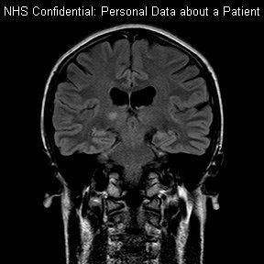
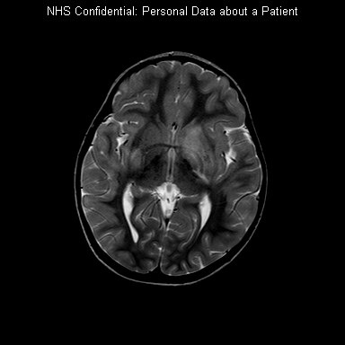
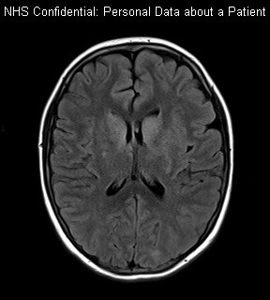
Basal ganglia/thalamic lesions in MOG-IgG1+ve patients
Maciej Juryńczyk
2yr child
11yr child
adult
14yr child
3yr child

Slide 22
MRI MOG Vs AQP4 VS MS

Slide 23
Overlap with MS and NMO
MS can present as:
recurrent ON
recurrent TM
sequential ON and TM
short lesions / TM: asymmetrical, post, white matter / MS MRI diagnostic criteria
17% OS MS had LETM
14% AQP4-Ab TM present with short TM lesions
‘Barkhof criteria for MS’ positive in 16% AQP4-Ab +ve patients
Lucy Matthews

Slide 24
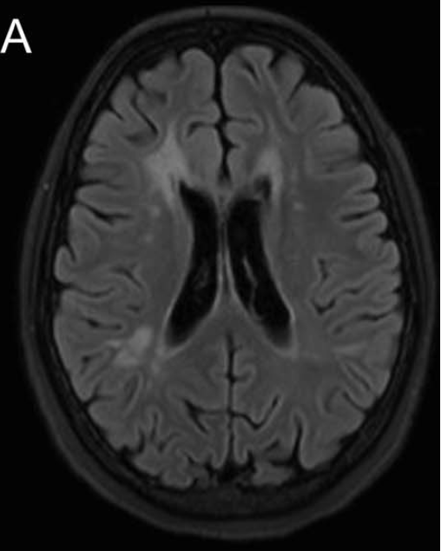
Conventional MRI to distinguish NMOSD from MS
Set up on AQP4-Ab disease, sensitivity 91%, specificity 95%, PPV 98%, NPP 83%
Dawson Finger U/S–shaped Juxtacortical lesion
Inf Temp and Lat Ventricle lesions
+
or
or
Lucy Matthews, Neurology 2013;80:1-8
= MS
Notes:
Using our findings we were then able to identify conventional brain MRI features for recognizing MS over NMO.

Slide 25
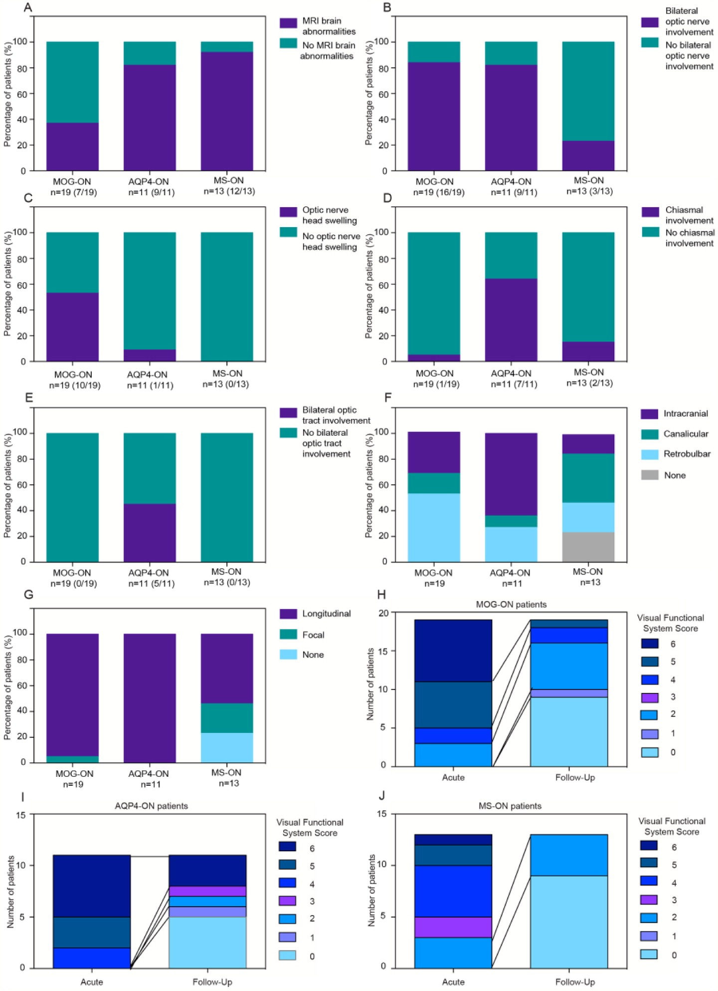
MRI MOG Vs AQP4 VS MS
Also clinicians detected more optic nerve head swelling
Ramanathan S et al . Radiological differentiation of optic neuritis with myelin oligodendrocyte glycoprotein antibodies, aquaporin-4 antibodies, and multiple sclerosis. Mult Scler. 2016 Apr;22(4):470-82.

Slide 26
2 blind scoring 29 features on earliest clinical scans
Assessing brain MRI discriminators of MOG-Ab disease
Bilateral lesions
Large (>2 cm)
Periventricular
Adjacent to the body of lateral ventricle
Subcortical white matter
Juxtacortical
S- or U-shaped juxtacortical
Involving cortex
Dawson’s fingers
Callosal
Diffuse splenium lesions
Inferior temporal lobe lesions
T1-hypointense
Adjacent to 3rd ventricle
Hypothalamic
Brainstem
Midbrain
Periaqueductal
Pontine
Adjacent to 4th ventricle
Medullary
Area postrema
Extensive lesions spreading from brainstem to basal ganglia
Basal ganglia
Thalamic
Cerebellar peduncles
Cerebellar
Fluffy
Number of lesions (<4, 4-9, >9)
Jurynczyk et al, Brain 2017

Slide 27
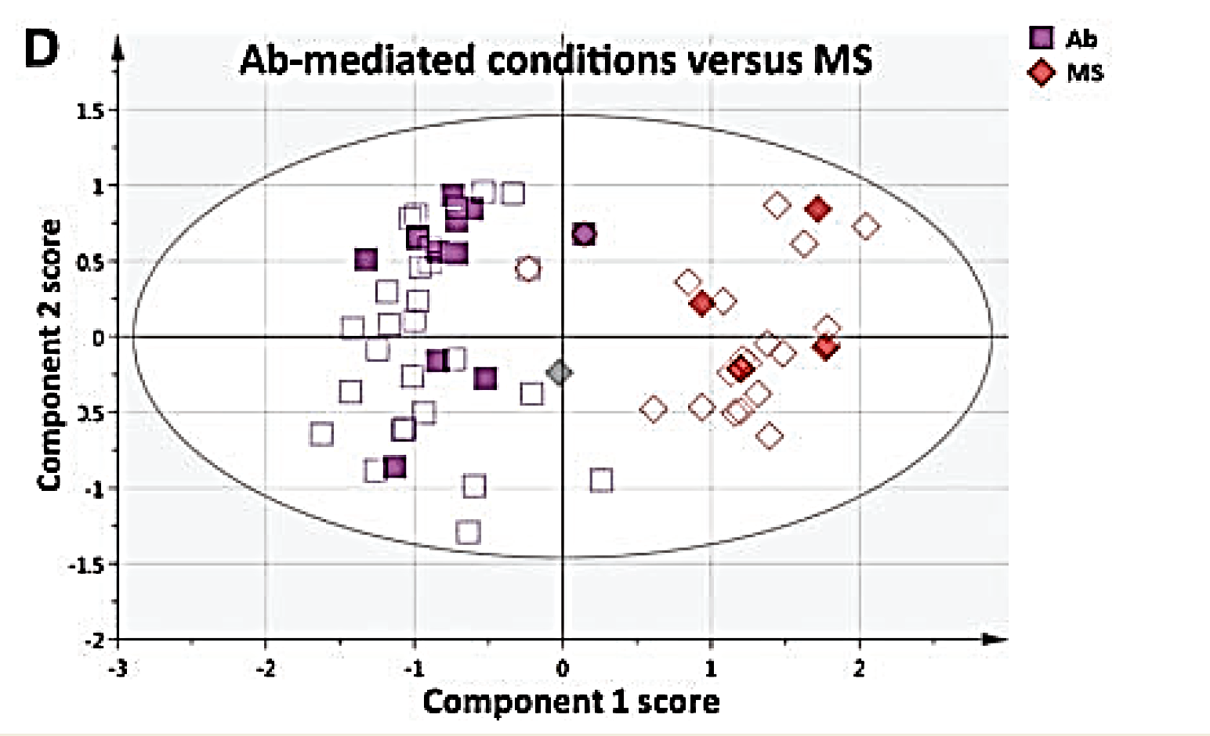
Antibody disease (AQP4 and MOG)
differentiates from MS
Jurynczyk Brain 2017;140:617-627

Slide 28
MRI MOG-Ab vs AQP4-Ab disease
MOG +ve similar to AQP4-Ab disease
More:
conus involvement (left w isolated sphincter and erectile dysfunction)
fluffy lesions (adults)
bilateral cerebellar peduncle lesions
thalamic/basal ganglia lesions
anterior and bilateral ON (papillitis)

Slide 29
AQP4-Ab Brain MRI
51% typical lesions
 | 18.1% brainstem periventricular/periaqueductal
 | 32.7% periependymal along lateral ventricles
 | 6.0% diencephalic
 | 4.3% corticospinal tract
 | 72.2% had spinal cord lesions
 |  | 46.3% long TM
 |  | 36.1% short TM
37.1% satisfied 2010 McDonald criteria
 | none had cortical lesions
Cacciaguerra L et al .Brain and cord imaging features in neuromyelitis optica spectrum disorders. Ann Neurol. 2019 Mar;85(3):371-384

Slide 30
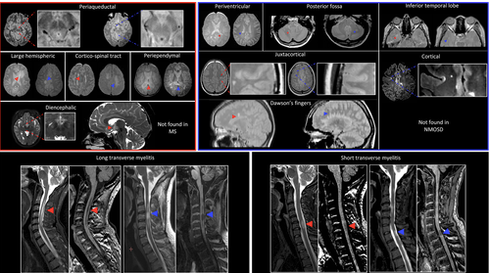
Examples of brain and spinal cord MRI findings in NMOSD (red arrowheads) and MS patients (blue arrowheads) are shown. In the red box, typical brain NMOSD lesions are shown; in the blue box, typical brain MS features are shown. In the lower panel, spinal cord findings are displayed
Cacciaguerra L et al .Brain and cord imaging features in neuromyelitis optica spectrum disorders. Ann Neurol. 2019 Mar;85(3):371-384

Slide 31
Eyes

Slide 32
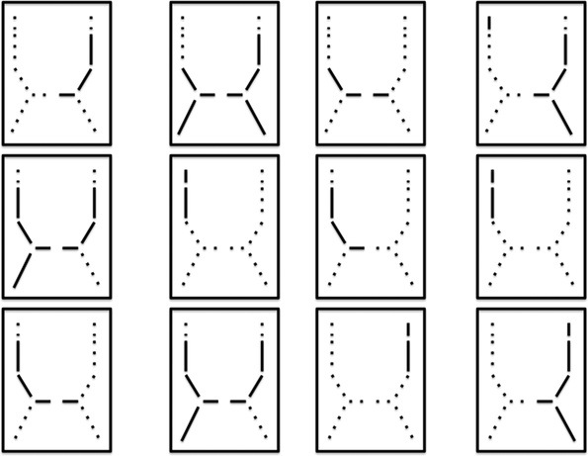
Eyes AQP4 MRI
NMO
Multiple Sclerosis
Distinguishing Optic Neuritis in Neuromyelitis Optica Spectrum Disease From Multiple Sclerosis: A Novel Magnetic Resonance Imaging Scoring System.
Storoni, Mithu; Davagnanam, Indran; Radon, Mark; Siddiqui, Ata; Plant, Gordon; MD, FRCP
Journal of Neuro-Ophthalmology. 33(2):123-127, June 2013.
DOI: 10.1097/WNO.0b013e318283c3ed

Slide 33
MOG Eye MRI
MOG +ve optic neuritis
100% enhancement optic nerve
50% perineural enhancement extending to orbital tissue
Chiasm & optic tract rarely affected
Chen JJ et al .Myelin Oligodendrocyte Glycoprotein Antibody-Positive Optic Neuritis: Clinical Characteristics, Radiologic Clues, and Outcome. Am J Ophthalmol. 2018 Nov;195:8-15
Notes:
Legend: A Case 1: T2-weighted fat-suppressed (A.a., axial) and T1-weighted fat suppressed MRI with Gd (A.b. axial, A.c. coronar) reveals swelling and Gd enhancementof the right optic nerve and perioptic sheath. Involvement of surrounding fat (white and black arrows). B Case 2: Coronar T2-weighted STIR MRI reveals bilateral swelling and edema of the optic nerves (white arrows). C Case 3, D Case 7: Axial T1-weighted MRI with Gd reveals bilateral swelling (white/ black arrows) and Gd enhancement of the optic nerves. E Case 8: Coronar T2-weighted STIR MRI reveals bilateral swelling and edema of the optic nerves (white arrows). R= right, L= left.

Slide 35
Predicting

Slide 36
Lesion length of optic neuritis impacts visual prognosis in neuromyelitis optica.. Akaishi T et al, J Neuroimmunol. 2016 Apr 15;293:28-33..
Notes:
The strongest predictor of visual prognosis was the axial ON lesion length in the acute phase (R = 0.747, p < 0.0001), which was not observed in patients with anti-MOG-Ab. Specifically, the ON lesion length within the intra-orbit and canalicular segments exhibited the strongest correlation with visual prognosis (R = 0.783, p < 0.0001). The ON onset age was also correlated with visual prognosis (R = 0.435, p = 0.0338). OCT data in the chronic phase also showed a correlation with visual prognosis, but they were much weaker than the ON lesion length in the acute phase

Slide 37
Female in her 30s
Presented with 3/52 of pain and reduced vision Right eye
VA CF R Left 6/5
R RAPD
Sl swollen disc
Notes:
P169759
Aug 2011

Slide 39
6 years later
lost to follow up and off all medication
3 week hx of pain around Left eye
Bilaterally HM
Notes:
Compared to 2017 OCT

Slide 44
Treatment
IV Steroids
PLEX
Azathioprine
Right CF Left 6/12, full colour and essentially full VF
Notes:
Compared to 2017 OCT

Slide 45
OCT in NMO
New technology + New disease + Small Sample Size
Lots of studies
But
foveal diameter in SCD
How well does structure correlate to function?

Slide 46
OCT in MOG and AQP4
Isolated optic neuritis cases
Nearly all MOG cases had disc swelling
pRNFL and GCIP thicker in MOG
and macular RNFL thickness no difference
patients experience less retinal neuronal loss than anti-AQP4+ ON despite severe optic nerve swelling.
Akaishi T et al. MRI and retinal abnormalities in isolated optic neuritis with myelin oligodendrocyte glycoprotein and aquaporin-4 antibodies: a comparative study.J Neurol Neurosurg Psychiatry. 2016 Apr;87(4):446-8.
Notes:
19 MOG +ve and 16/17 had disc swelling
9 AQP4 +ve and 1/9 had disc swelling
pRNFL higher in MOG (90.2±10.5 vs 74.1±14.9 µm)
GCIPL thicker in MOG (57.0±6.2 vs 46.1±12.3 µm)
macular RNFL thickness no difference (26.5±5.4 and 23.7±11.6 µm)

Slide 47
MOG +ve Vs AQP4 +ve
no significant differences in any structural or functional visual parameters (pRNFL, GCIP, microcysts VA)
BUT
significantly higher annual ON relapse rate (median 0.69 vs. 0.29 attacks/year) so on average a single ON episode caused less damage in MOG+ve
pRNFL and GCIP loss correlated with the number of ON episodes in MOG+ve but not in AQP4+ve
Pache F et al. MOG-IgG in NMO and related disorders: a multicenter study of 50 patients. Part 4: Afferent visual system damage after optic neuritis in MOG-IgG-seropositive versus AQP4-IgG-seropositive patients. J Neuroinflammation. 2016 Nov 1;13(1):282

Slide 48
Level of clinical effect
The visual acuity, tested at the 6-month visit in MOG-ON patients, was as good as in seronegative-ON patients, despite RNFL thinning in the RNFL and GCC that was as extensive as that in AQP4-ON patients
Zhao G et al. Clinical characteristics of myelin oligodendrocyte glycoprotein seropositive optic neuritis: a cohort study in Shanghai, China. J Neurol. 2018 Jan;265(1):33-40.

Slide 49
BUT
Neither MRI or OCT predicts the following

Slide 50
A man in his 50s
Pain on eye movements
Vision dropped
VA CF R+L
Discs swollen
Notes:
V453156
Admitted April 2015

Slide 51
April 2015

Slide 54
May 2015

Slide 56
Tx: Steroids
MOG +ve
1/12 later pain recurred and steroids increased
12/12 vision Left eye dropped
Tx: IVMP and azathioprine
VA 6/9 R+L June 2016
17/17 Ish 10/17

Slide 57
Reduced vision Right eye Feb 2017
Bilateral reduction vision Jan 2018
Tx: IVMP and mycophenolate
Reduction Right vision July 2018
Tx: IV MP+ PLEX and Cyclophoshamide + Methotrexate
VA 6/24 VA CF Feb 2019
Reduction Right eye March 2019
PLEX and Rituximab
VA HM + PL April 2019

Slide 58
4 years later

Slide 59
Another caveat
35 year old man
Seen in emergency service
Presented with 3-4/7 of pain and cloudy vision Right eye
VA Right 6/6 Left 6/4
? swollen disc
OCT Normal
Notes:
K090061

Slide 60
Six days later
VA Right CF Left 6/9
Started on steroids
Notes:
K090061

Slide 63
2 months vision back to normal
AQP4 -ve
MOG -ve
Notes:
K090061

Slide 64
Subclinical loss AQP4
AQP4-ab +ve NMOSD with LETM but no ON Vs AP4 +ve with ON
Foveal thinning both groups
GCIP + pRNFL thinning only in ON group
pRNFL increased in LETM group
Longitudinal GCIP loss seems to be independent of episodes of ON
Oertel FC et al . Microstructural visual system changes in AQP4-antibody-seropositive NMOSD. Neurol Neuroimmunol Neuroinflamm. 2017 Feb 22;4(3):e334.
Oertel FC et al. Retinal ganglion cell loss in neuromyelitis optica: a longitudinal study. J Neurol Neurosurg Psychiatry. 2018 Dec 89(12):1259-1265.
Notes:
Of 51 screened patients with NMOSD from a longitudinal observational cohort study, we compared 6 AQP4-ab–seropositive NMOSD patients with longitudinally extensive transverse myelitis (LETM) but no history of optic neuritis (ON) or other bout (NMOSD-LETM) to 19 AQP4-ab–seropositive NMOSD patients with previous ON (NMOSD-ON) and 26 healthy controls (HCs).

Slide 65
Subclinical loss MOG
7 out of 10 patients without ON had abnormal pRNFL and mGCC
Pandit L et al. MOG-IgG-associated disease has a stereotypical clinical course, asymptomatic visual impairment and good treatment response. Mult Scler J Exp Transl Clin. 2018 Jul 17;4(3):2055217318787829.

Slide 66
AQP4 expression
ON + Retina
ERG, OCT & Histology AQP4+ve Vs MS
Specific areas of thinning in fovea
(Henle fibre outer nuclear layer + inner segment)
Correlated with the ERG abnormality (b-wave)
Muller cell-specific AQP4 expression greater in fovea than periphery
suggesting Muller cell dysfunction in the eye
Muller cell
AQP4
Retina
Choroid
Sclera
Astrocyte
AQP4
You Y et al. Evidence of Müller Glial Dysfunction in Patients with Aquaporin-4 Immunoglobulin G-Positive Neuromyelitis Optica Spectrum Disorder. Ophthalmology. 2019 Jun;126(6):801-810. doi: 10.1016
Notes:
Diffuse grey matter staining and atrsocyte foot process esp around vessels pos in white matter (arrowheads AFP) arrows AFP around vessels

Slide 67
The Future
OCT analysis
Pit depth & rim height differed between controls and patients with autoimmune neuroinflammatory diseases (with and without previous optic neuritis)
Yadav SK et al. CuBe: parametric modeling of 3D foveal shape using cubic Bézier. Biomed Opt Express. 2017 Aug 22;8(9):4181-4199.

Slide 68
The Future
MRI analysis
Kuchling J et al . Comparison of probabilistic tractography and tract-based spatial statistics for assessing optic radiation damage in patients with autoimmune inflammatory disorders of the central nervous system. Neuroimage Clin. 2018 May 8;19:538-550
Papadopoulou A et al. Attack-related damage of thalamic nuclei in neuromyelitis optica spectrum disorders. J Neurol Neurosurg Psychiatry. 2019 May 24. pii: jnnp-2018-320249. doi: 10.1136/jnnp-2018-320249.

Slide 69
Conclusions
MRI
can help to make diagnosis
particularly differentiating from MS
can give a prognosis
but c.50% AQP4+ve patients no classical features
OCT studies
in spite of caveats
suggest subclinical retinal atrophy

Slide 70
Acknowledgements
NMO UK Service based Oxford
particularly Jackie Palace & Maria Isabel Leite
Ophthalmology & Neurology teams at KCH
particularly the junior doctors
Neuro-radiology Dept at KCH
particularly Jon Hart & Naomi Sibtain

